Slide 1

A Seven Days Workshop on: Cricket Analytics

Slide 2
Content of workshop
Day 1 : Introduction With Basic Of Python
Day 2 : Introduction To Cricket Analytics
Day 3 : About Pandas And Matplotlib
Day 4 : Sachin Vs Virat: Analytical Debate
Day 5 : Matchup: ABD Vs Bumrah
Day 6 : Session About How To Prepare A IPL Scorecard
Day 7 : Live/QA Session

Slide 3
Introduction to cricket analytics
Cricket Analytics is about summarizing the sports data in the form of numbers.
Cricket Analytics is simply the study of analytical data involving players and their performances in order to determine their weaknesses and strengths.
Cricket analytics is on the rise and will continue to play a significant role in how teams operate, pick their players, how they play the game, etc.
The runs scored by a batsman, the wickets taken by a bowler, or the matches won by a cricket team – these are all examples of the most important numbers in the game of cricket.

Slide 4
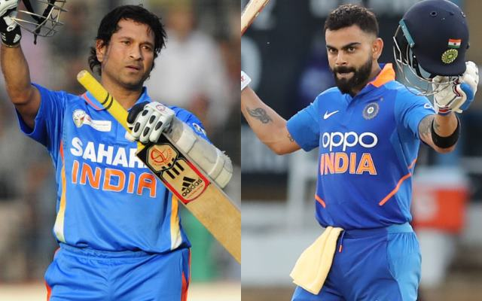
Case study 1: Sachin vs Virat Analytical Debate
Objectives:
Runs per innings by both sachin and virat
Strike rate of sachin and virat
Total no. 100’s by sachin and virat
Total no. 50’s by sachin and virat
Individual contribution of runs for the team

Slide 5
Sachin vs Virat Analytical Debate
Result :
Parameter | Sachin | Virat | Winner
Runs Per Innings | 1.94 | 2.03 | Virat
Strike Rate | 1.22 | 1.12 | Sachin
100’s Per Match | 0.15 | 0.18 | Sachin
50’s Per Match | 0.57 | 0.55 | Virat
Team Contribution | 16.90% | 17.61% | Virat

Slide 6

Case study 2: Matchup: ABD Vs Bumrah
Objectives:
No. of runs scored
No. of balls faced
No. of times dismissed
Strike rate of ABD against Bumrah

Slide 7
Matchup: ABD Vs Bumrah
Result :
Balls Faced | 79
Runs Scored | 114
Outs | 2
Strike Rate | 144.00

Slide 8
Conclusion Of First Case Study :
Virat Has More Runs Per Innings Than Sachin.
Virat Has Contributed A Lot Runs To The Team's Victory Than Sachin.
Virat Has Scored More No. Of 50’s Than Sachin.
Conclusion Of Second Case Study :
ABD Has 140+ Strike Rate Against Bumrah and He Scored More Than 120 Runs Against Him.

Slide 9
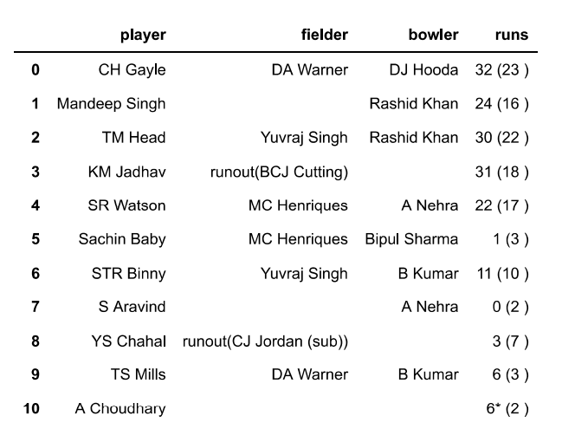
IPL Scorecard Using Python
Match Date: 5 April 2017
RCB Won The Toss And Decided To Bowl.
Sunrisers Hyderabad
vs
Royal Challengers Bangalore
SCORE
SRH : 207/4 (20)
RCB : 172 (19.4)
Match Result:
SRH Won By 35 Runs

Slide 10
Thank You !!

